Slide 1

Introduction to next generation microbiome data analytics
Open & reproducible microbiome data analysis spring school
Wageningen, The Netherlands, May 28-30, 2018
Gerben DA Hermes, PhD
Laboratory of Microbiology,
Wageningen University & Research

Slide 2
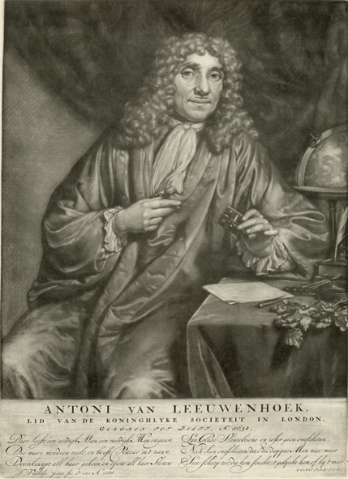
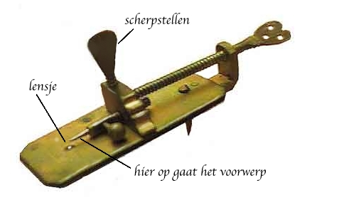
‘previous generation’ microbiomics
The Godfather
1632 - 1723
>1674
Spermatozoa
Blood cells
Dental plaque

Slide 3
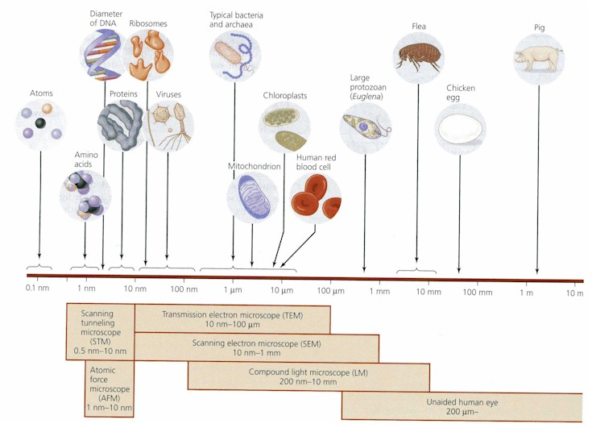
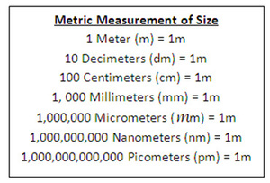
A sense of scale

Slide 4
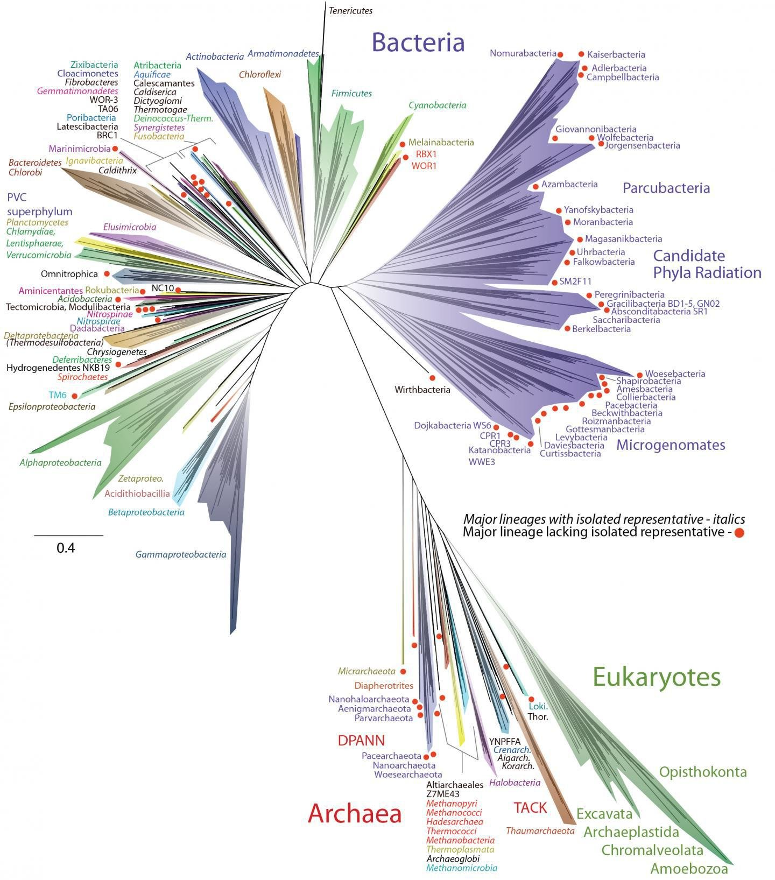
The tree of life
Earth’s biodiversity
relatedness/evolution/time

Slide 5
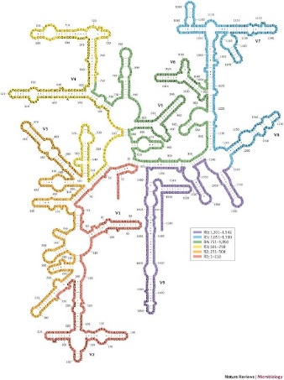
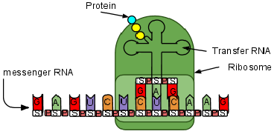
Building a prokaryotic phylogenetic tree Target gene: Molecular clock
16S rRNA gene: ~1500nt
Target for detection & identification of bacteria.
Ideal phylogenetic marker.
Universally distributed, functionally constant,
Sufficiently conserved, no horizontal transfer (?)
More than 3,000,000 sequences in databases.
Alternating variable and conserved sequence domains.
variability
base position

Slide 6
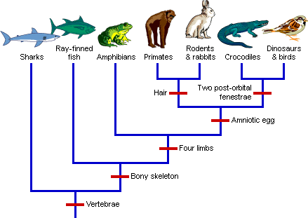
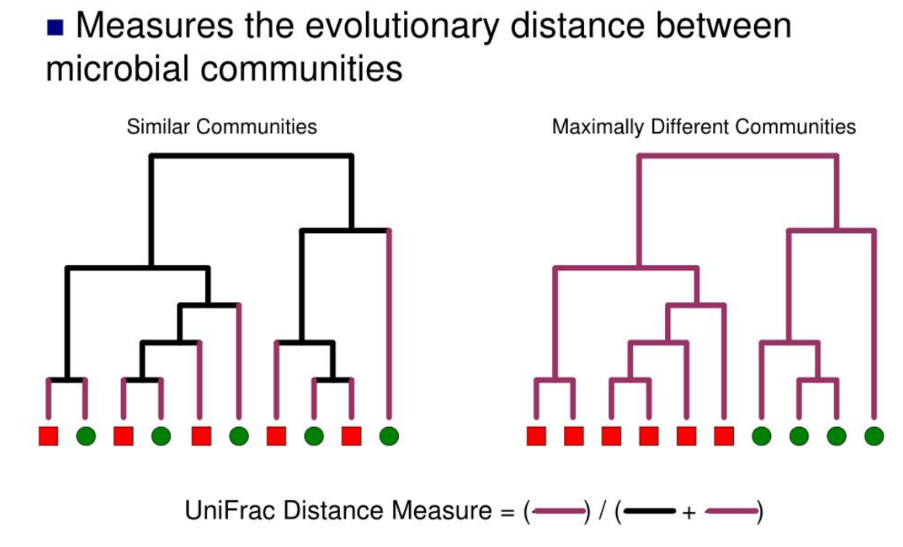

Slide 7
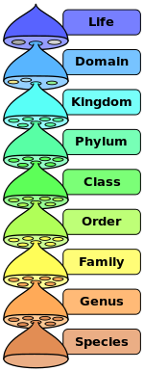
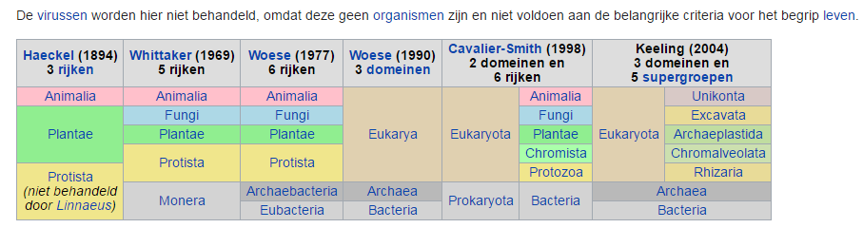
Classification of all known life prokaryotic species concept
16S rRNA gene similarity prokaryotes
~88%
DNA-DNA hybridization (70%)
%G+C content
Free fatty acid analysis
morphological, biochemical and physiological characterization
Almost free exchange of genomic info
~92%
~95%
~97%
16S rRNA gene Escherichia Coli & Salmonella >98% similar

Slide 8
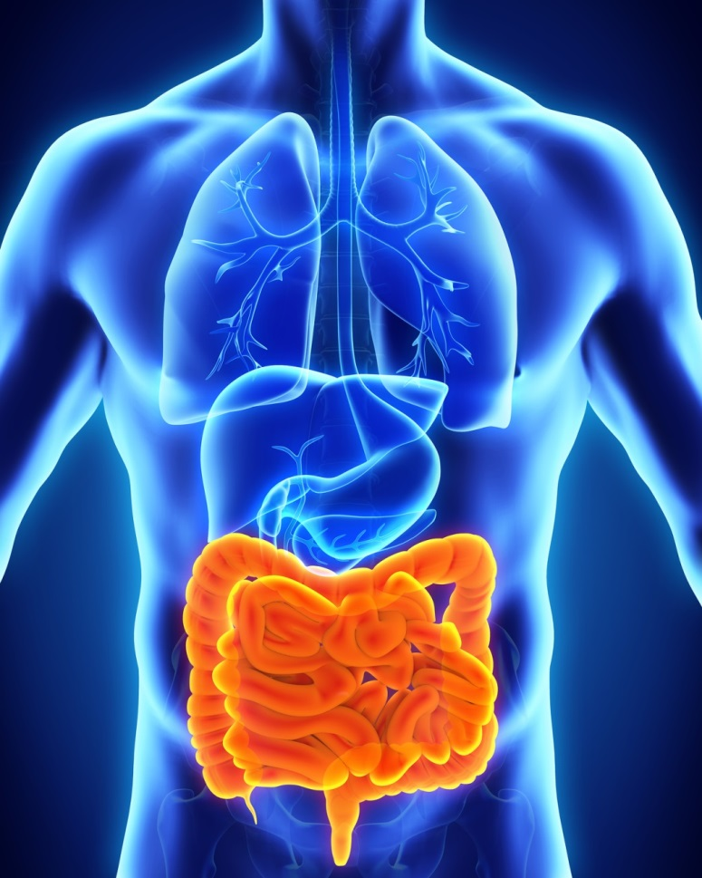
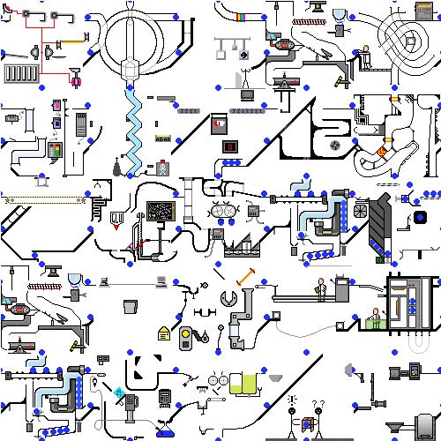
Human gastro-intestinal microbiota
Complex and diverse ecosystem
~ 100 +/- 50 species/ind (>200 strains), ~1000 sp. identified
5 dominante phyla: Firmicutes, Bacteroides, Proteobacteria, Actinobacteria and Verrucomicrobia
Associated with numerous phenotypes/diseases states
© Fuentes 2017

Slide 10
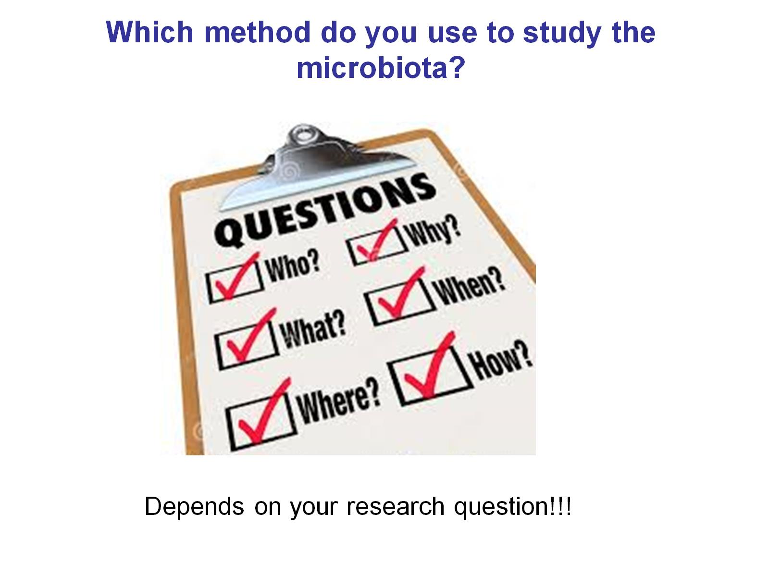
© Zoetendal

Slide 11
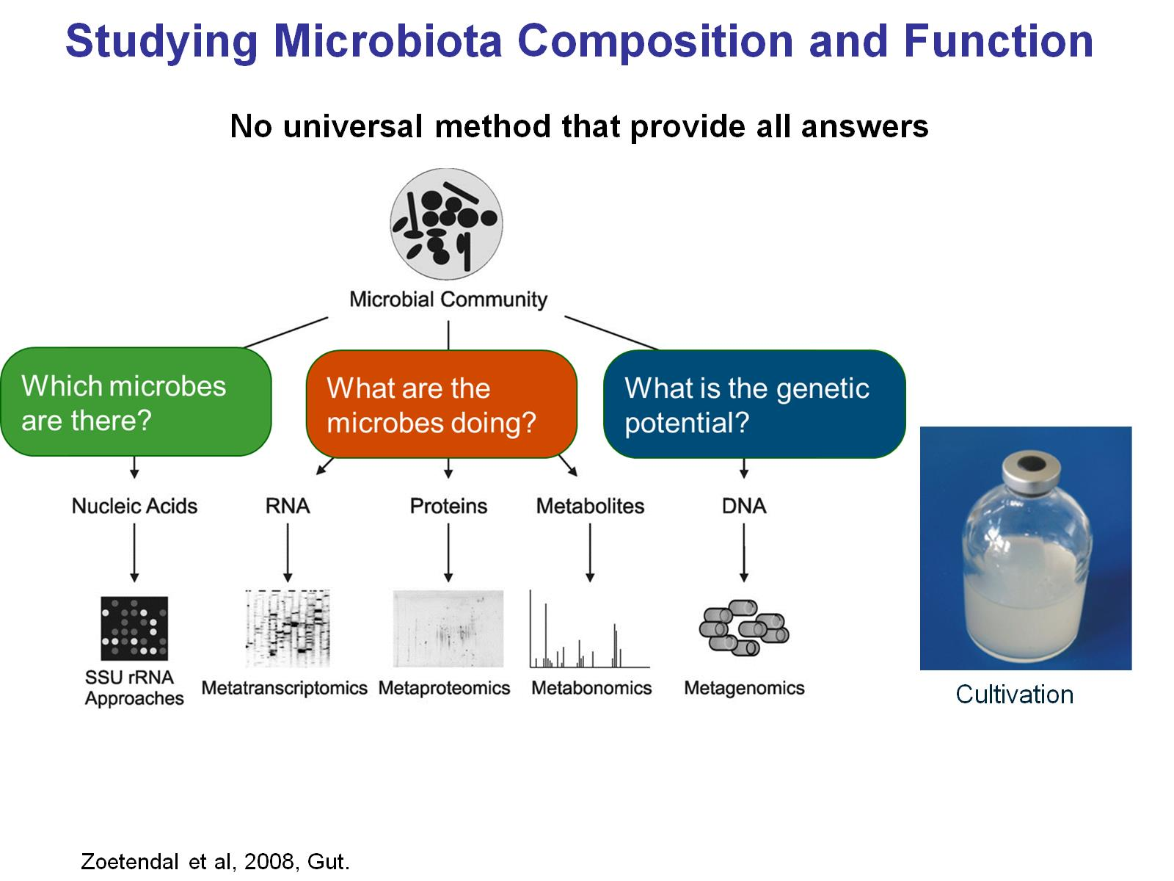

Slide 12
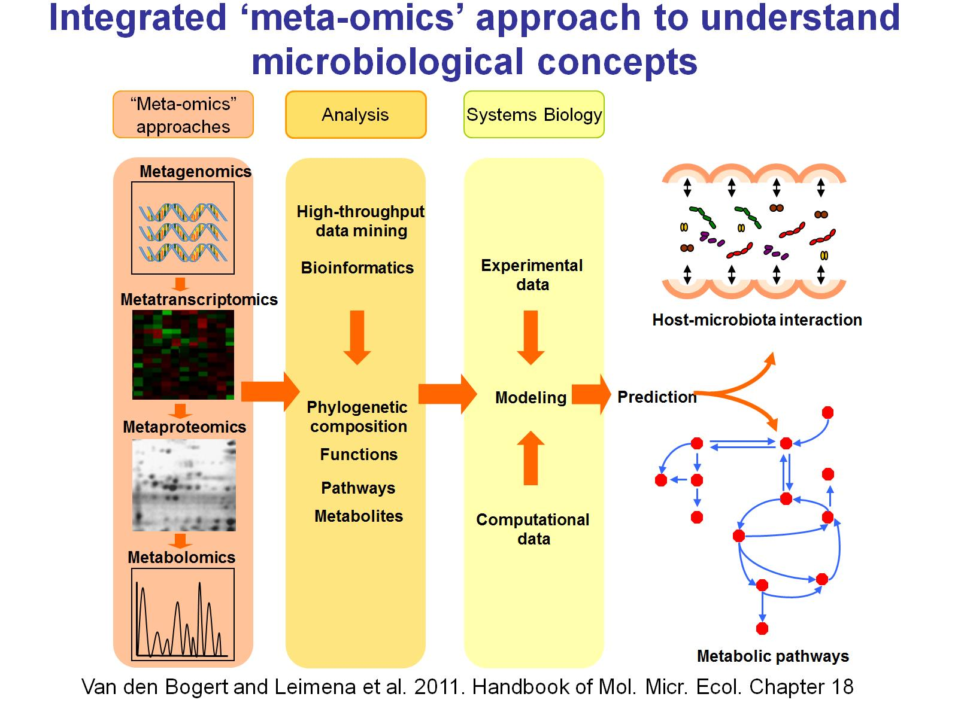

Slide 13
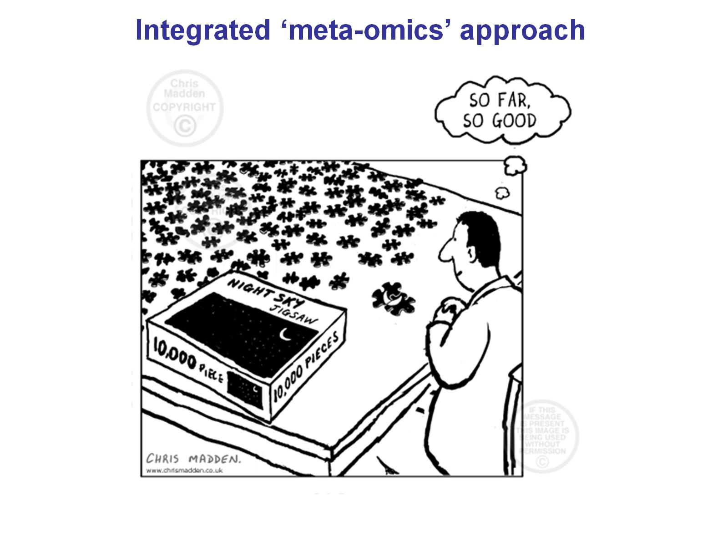

Slide 14
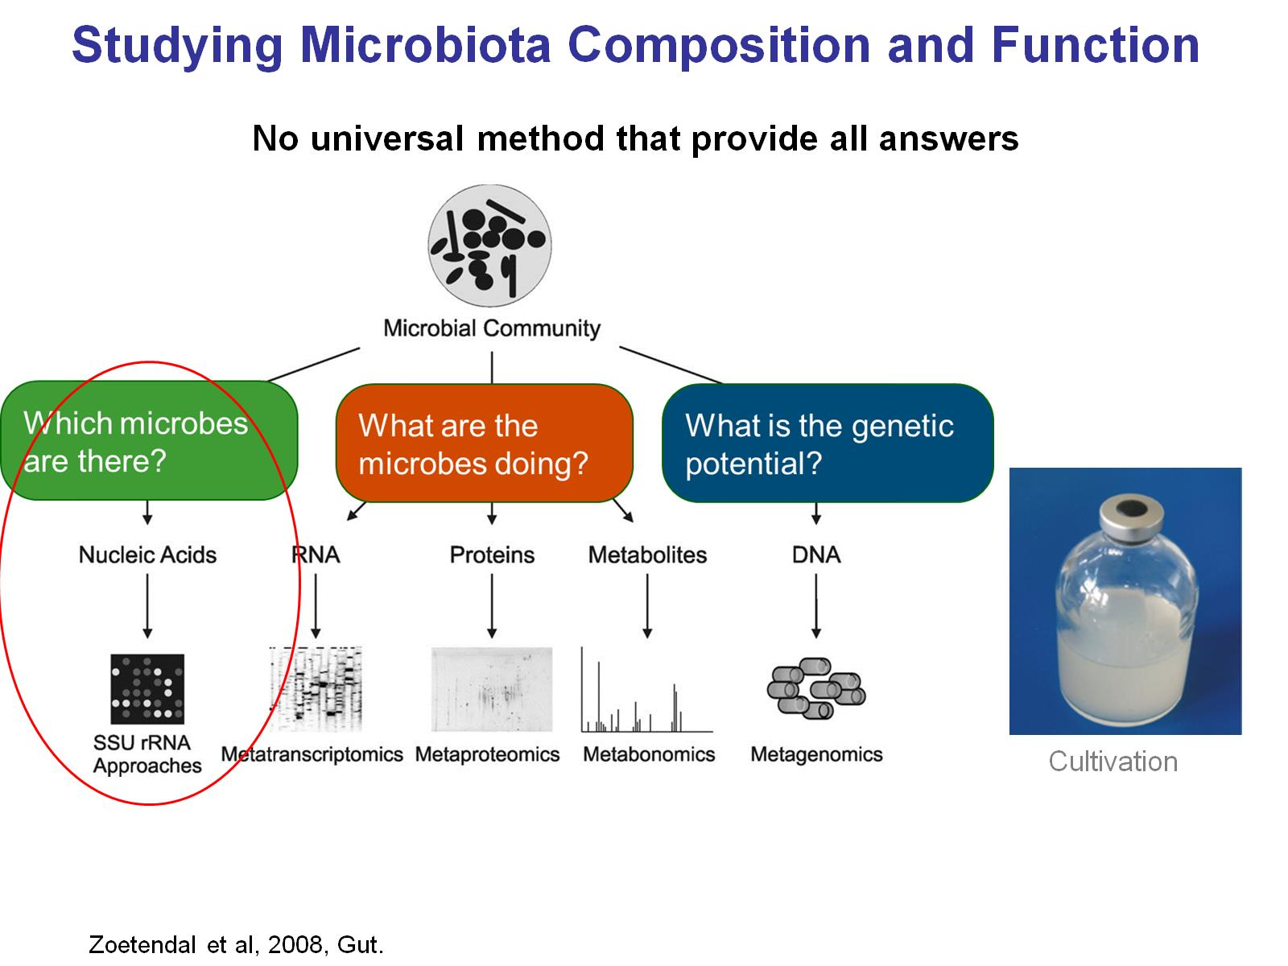

Slide 15
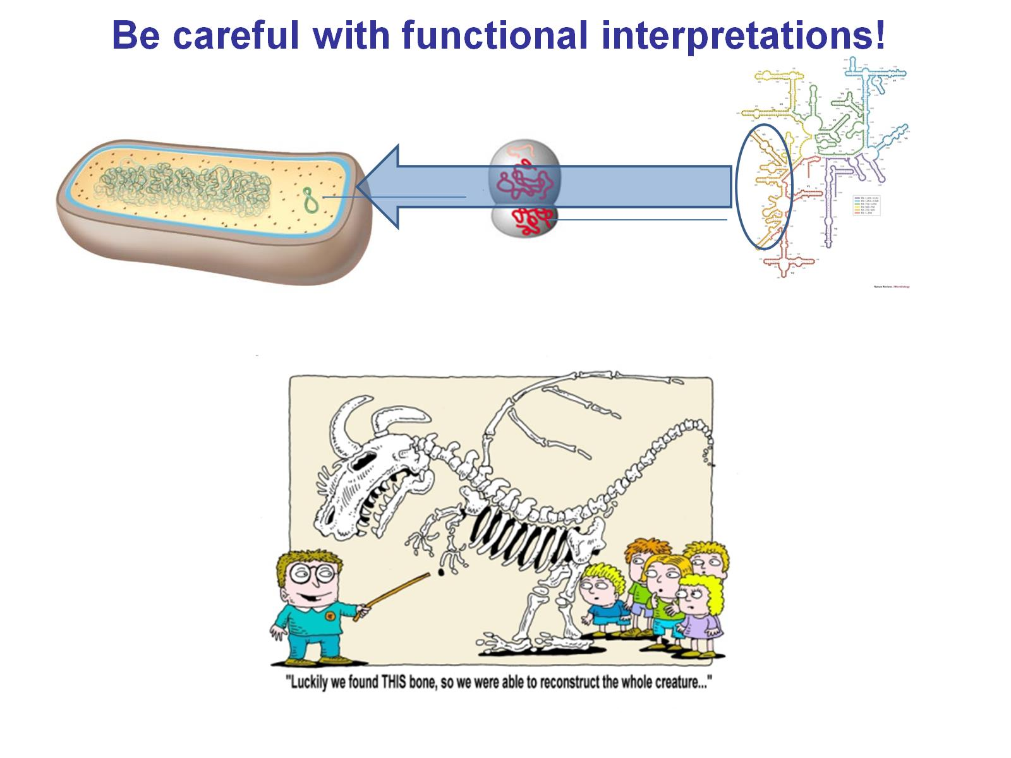

16S rRNA gene based approaches
Target for detection & identification of bacteria.
Ideal phylogenetic marker.
Universally distributed, functionally constant,
Sufficiently conserved, ‘no’ horizontal transfer (?)
More than 3,000,000 sequences in databases.
Alternating variable and conserved sequence domains.
variability
base position

Slide 16
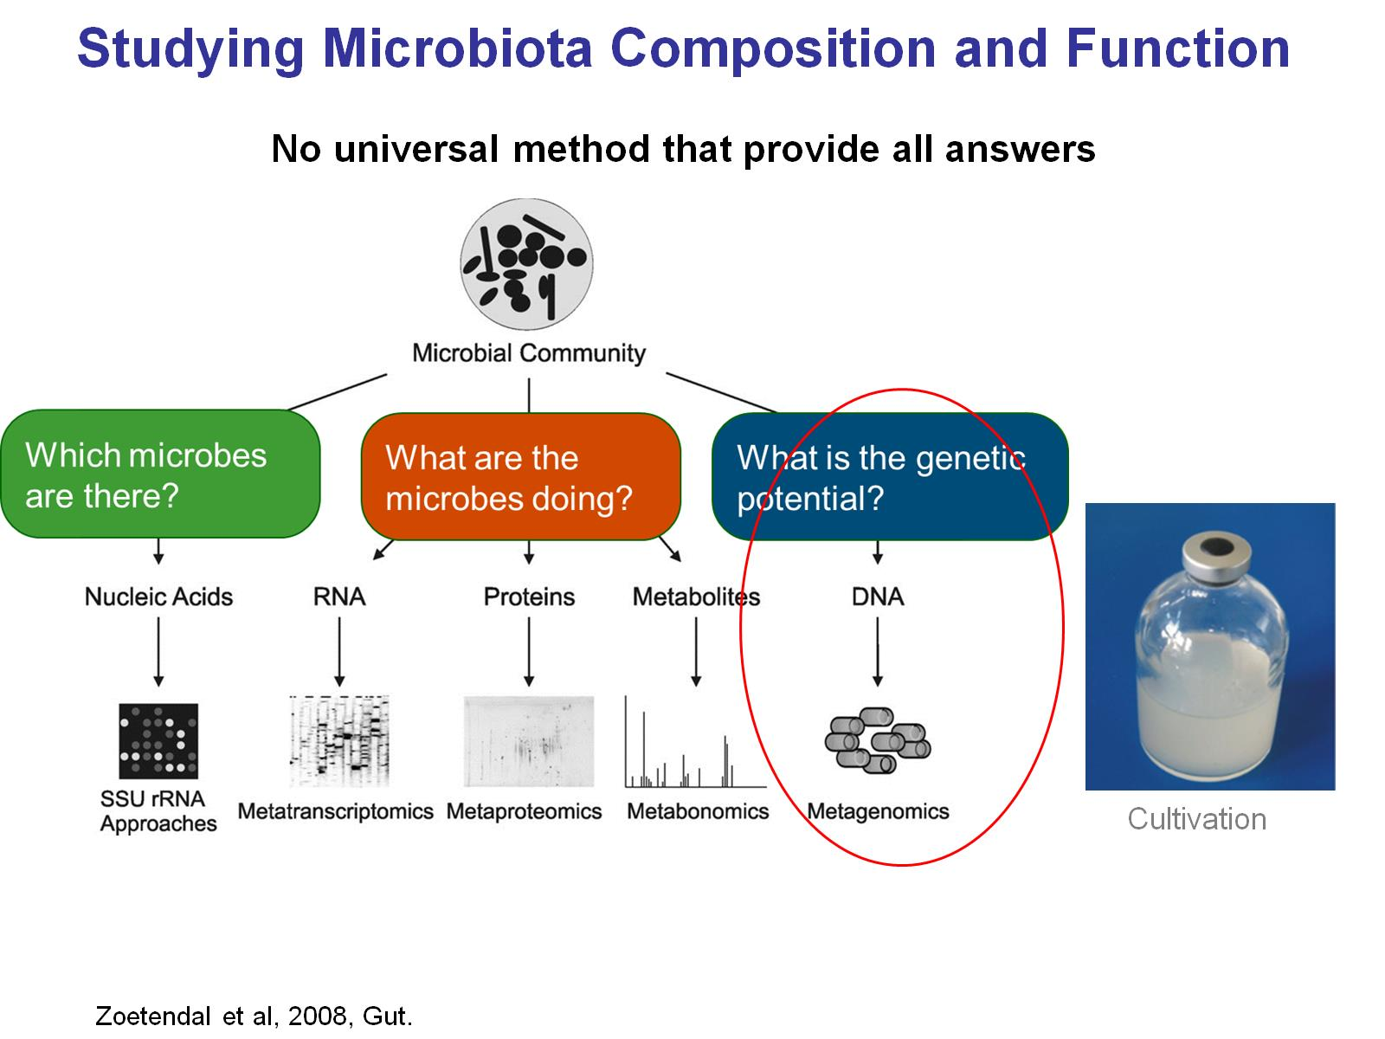

Slide 17


Slide 18
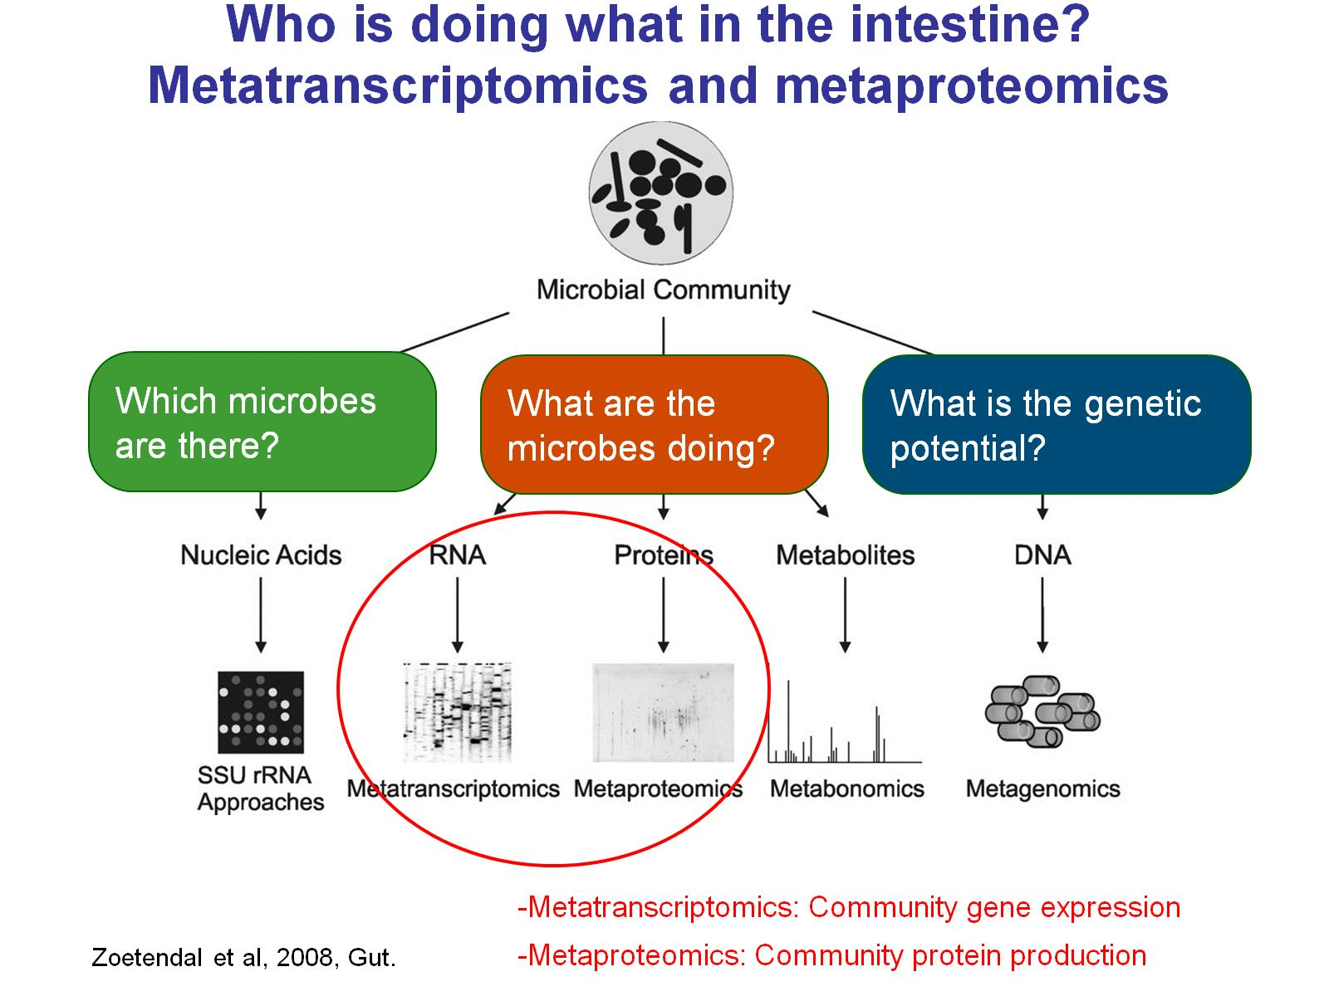

Slide 19
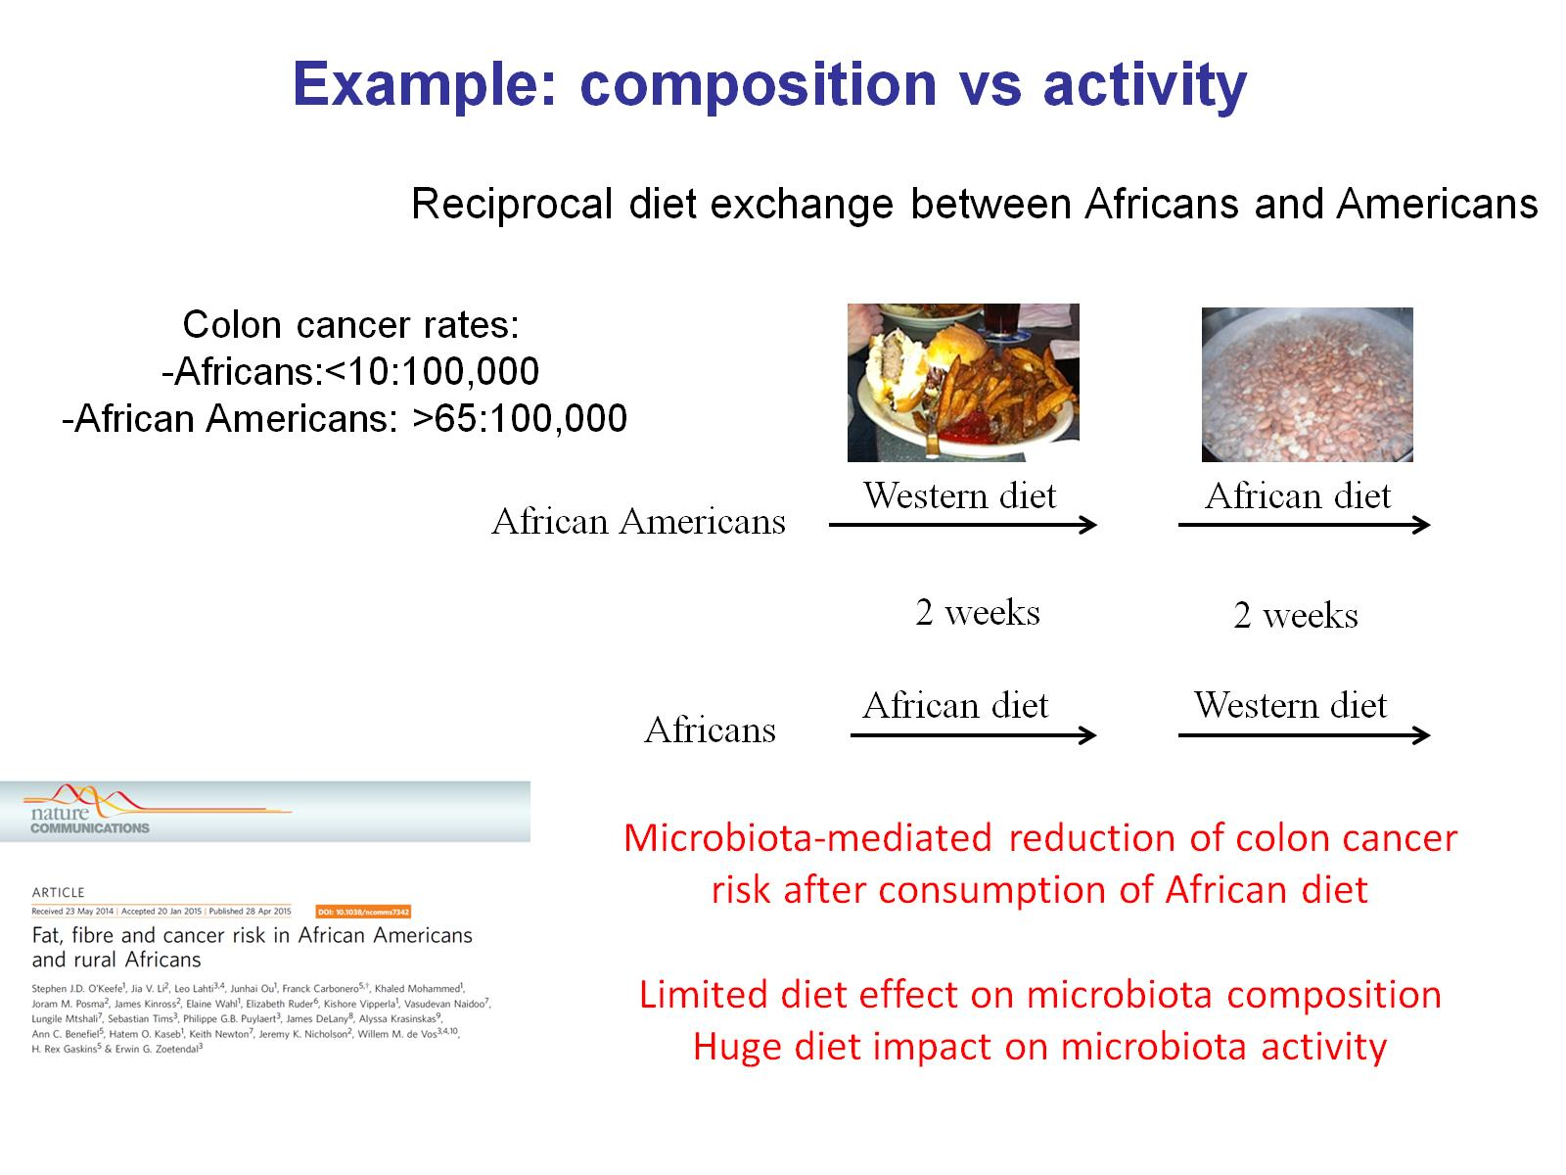

Slide 20


Slide 21
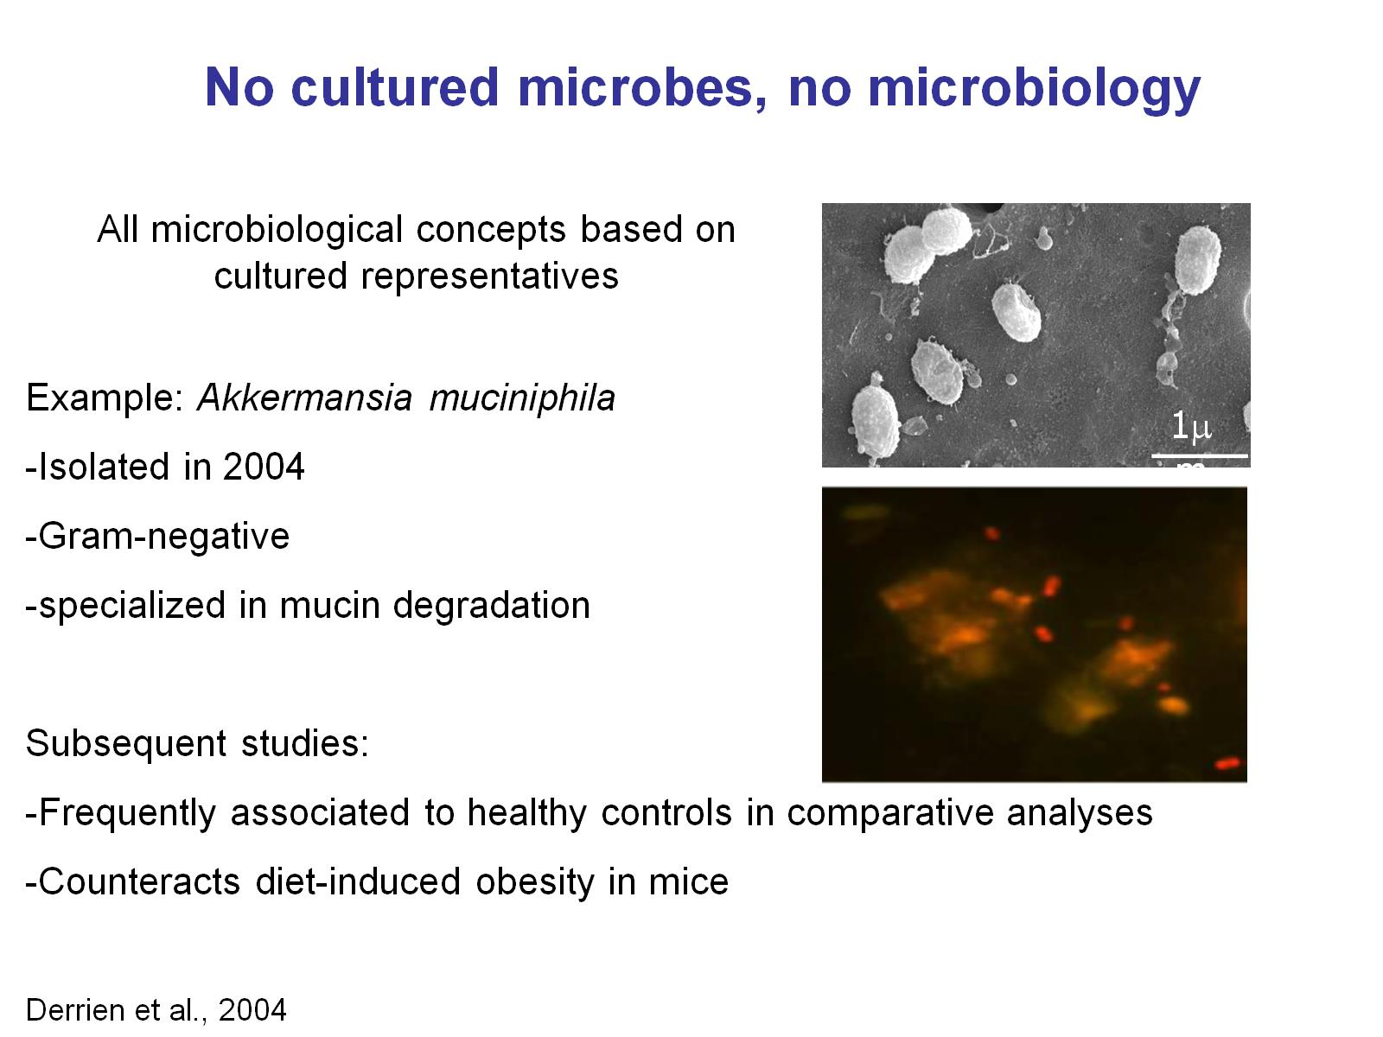
Previous generation microbiomics

Slide 23
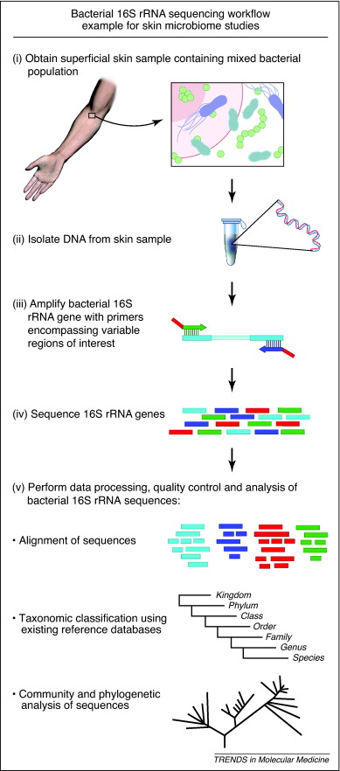


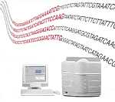
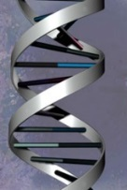
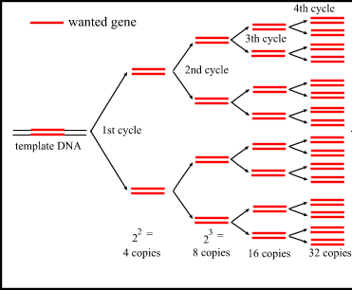
16S rRNA gene amplicon sequencing workflow
DNA extraction
PCR
Community profiling with NGS

Slide 24
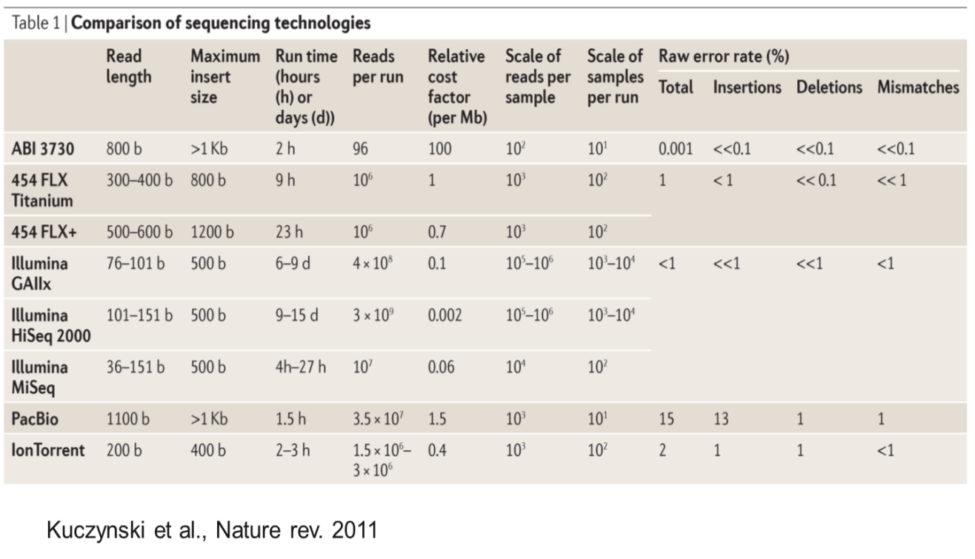
‘Next Generation’ Sequencers

Slide 25

Why Next Generation Sequencing?
Resolution
Sanger: long sequences > more taxonomic information 450 – 1200 bp
NGS shorter sequences > less taxonomic information 50 – 450 bp
Data
Sanger: 10, 100, 200 sequences ... (time & $)
NGS 200.000 to > 1.000.000.000 sequences (much cheaper/sequence)

Slide 26

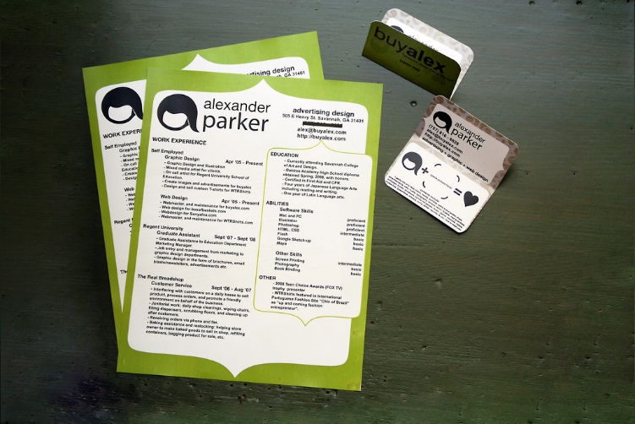

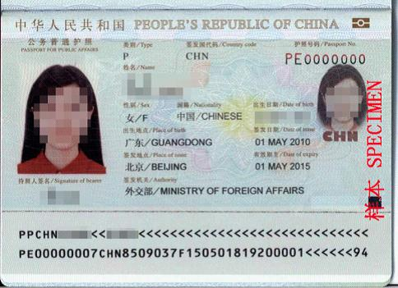
Amplicon sequencing
20.000 people/country
20 people/country

Slide 27
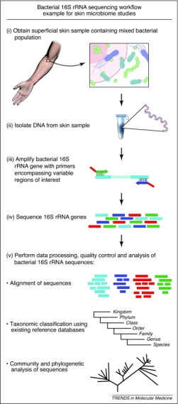
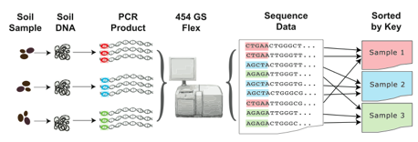
PCR
what to do with 10.000.000 sequences?
1 sample; pick 10.000.000 colonies
Or
100.000 colonies from 100 samples
Barcoding & multiplexing
Sorted by
barcode

Slide 28
Analysis pipeline/workflow
OTU -> Operational Taxonomic Unit (nt sequence -> biological entity)
+ QC
= OTU table

Slide 29
Weeks/months
Biological interpretation
Hypothesis testing
Months/year?
Day 2/3

Slide 30
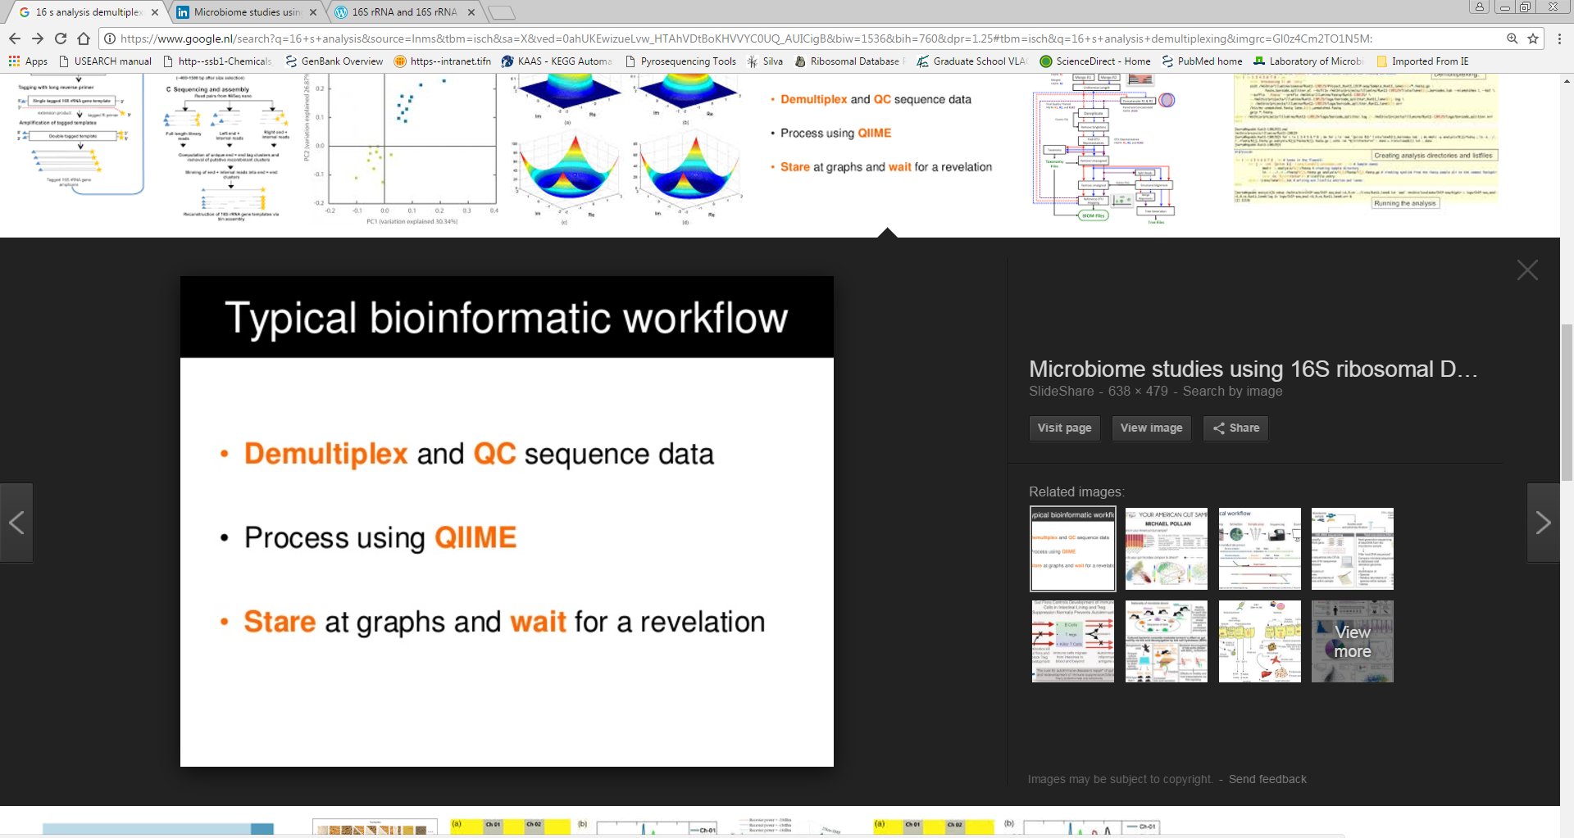
The hard part....
Day 2/3

Slide 31
Recap

